Slide 1
ATTITUDES AND NORMATIVE BELIEFS AS FACTORS
INFLUENCING BEHAVIORAL INTENTIONS
ICEK AJZEN AND MARTIN FISHBEIN
University of Illinois
Journal of Personality and Social Psychology 1972, Vol. 21, No. 1, 1-9
Şebnem AÇIKYÜZ

Slide 2
OUTLINE
What is TRA?
Concern Of The Theory
Methodology
Questionnaires
Results
Change Study
  Methodology
  Results
Conclusions

Slide 3
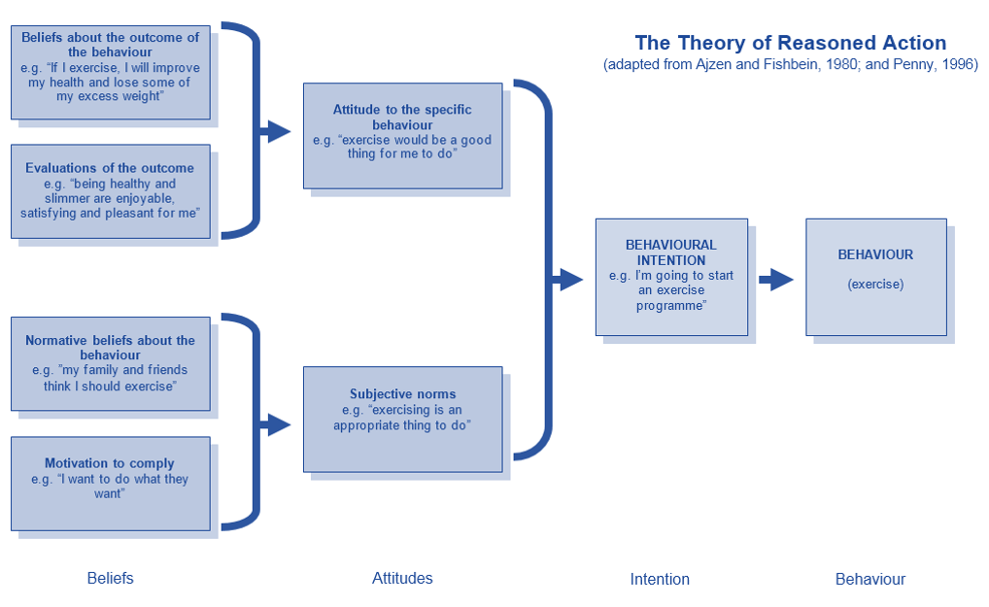

Slide 4
CONCERN OF THE THEORY
The prediction of behavioral intentions (BI) which are assumed to mediate overt behavior.
An individual's intention to perform a given act is a joint function of
+
beliefs about what others expect him to do in that situation, normative beliefs (NB)
attitude toward performing that behavior (Aact)

Slide 5
CONCERN OF THE THEORY
Symbolically, the theory can be expressed as follows:
B: overt behavior, BI: behavioral intention;
Aact: attitude toward the act;
NB: normative belief;
Mc: motivation to comply with the normative belief;
w₀ and w₁ are empirically determined weights.
B~BI = [Aact] w₀ + [NB(Mc)] w₁
Notes:
It can be seen that behavioral intentions (and corresponding overt behaviors) are a function of the weighted sum of two components,Aact and NB(Mc).

Slide 6
CONCERN OF THE THEORY
The relative importance of these two components (Aact and NB), that is, their weights, is expected to vary
  with the kind of behavior that is being predicted,
  with the conditions under which the behavior is to be performed,
  with the person who is to perform the behavior.

Slide 7
CONCERN OF THE THEORY
(Atkinson, 1957; Peak, 1955;
Rosenberg, 1956; Rotter,1954)
(Edwards, 1961)
A person's attitude toward a specific act is proposed to be a function of the act's perceived consequences and of their values to the person.
Aact is conceptualized in terms of an expectancy-value model:
B_{i}: individual's belief about the likelihood that the behavior in question will result in Outcome i;
a_{i}:the person's evaluation of (or attitude toward) Outcome i;
n is the number of beliefs.
Subjective Expected Utility (SEU) of a given alternative is a function of:
SPi: the subjective probability that certain outcomes will follow the act;
Ui: the respective subjective values (or utilities) attached to these outcomes.
_{n}
SEU = ∑ SP_{i}U_{i}
^{i=1}
_{n}
Aact = ∑ B_{i}a_{i}
^{i=1}
A direct measure of Aact will tend to be more general than most measures of Subjective Expected Utility
and
the correlation between Aact and Subjective Expected Utility will NOT be perfect.

Slide 8
CONCERN OF THE THEORY
A good deal of information is available concerning ;
Aact → the theory's attitudinal component.
NB(Mc) →the theory's normative component.
On the basis of the considerations is it proposed that Aact and NB can be manipulated (variations in SP and variations in SP0).
Whether or not a change in Aact or NB will significantly affect intentions will depend on the relative weights of these two components in the prediction of intentions.
The higher the weight of a given component, the more should change in that component be reflected in behavioral intentions.

Slide 9
METHODOLOGY
Four different hypothetical situations were formulated for use in the experiment. In each of the situations, an element of risk was involved in making a behavioral choice.
In two of them Aact would be more important than NB in predicting behavioral intentions, while in the other two, NB would be the more important determinant.
The description of each situation included two levels of probability indicating
the subject's own estimate of the likelihood that the proposed action would lead to success,
the likelihood of success as estimated by his close family and friends.
For a given subject in a given hypothetical situation these probability levels were
70% - 70%
70% - 30%
30% - 70%
30% - 30%

Slide 10
METHODOLOGY
The four hypothetical situations in their four different conditions of risk were given to
56 undergraduate students, both males and females.
The subjects were randomly divided into the experimental conditions on
the basis of a Latin square design such that a given subject responded only once to each hypothetical situation and only once to each of the four conditions. Thus,
there were 14 subjects in each situation-condition combination.

Slide 11







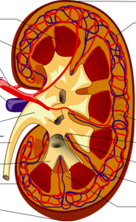
METHODOLOGY
 | Over the last few years you have done some part-time work and you have saved the amount of $1,000.You would now like to invest this money profitably. It has come to your attention that a plot of real estate in a developing residential area is available for the amount of money in your possession. If a planned building project proves successful, the plot of land might double its present value. However, if the project fails, you would lose your entire investment.
 | You have been informed by your physician that you have developed a severe liver ailment. The disease is sufficiently serious to force you to change many of your life habits—reducing your work load, drastically changing your diet, giving up your favorite leisure-time pursuits. Your physician suggests that a delicate medical operation could be attempted which, if successful, would completely relieve the liver condition. But its success cannot be assured, and, in fact, the operation might prove fatal.
 | As part of your job with a national company, you have to leave town for 2 years. You are therefore looking for someone to rent your house for the period of your absence. In response to your advertisement in a local newspaper a Negro family applies for the lease. Since your house is located in a white suburban neighborhood you find yourself in a difficult situation. Your neighbors may readily accept the Negro occupants, and there will be no problems. However, they might react negatively, and could even go so far as to attack the Negro family or damage your home. In this case you would find it extremely difficult to return to your home and live with your neighbors.
 | Your brother whom you deeply admire is in precarious health. Within the next few days a kidney transplant has to be performed. As a member of the family you are a suitable donor, and you are approached by the physician to donate one of your kidneys. Although there is no immediate danger to your own life, the transplant would of course have some effect on your health, and would restrict your way of life. If successful, the transplant would save your brother's life. However, its success cannot be assured and, in fact, your brother might die anyway.

Slide 12
METHODOLOGY
Each situation was followed by a paragraph ascribing a probability of success to the subject as well as to his close family and friends.
The following is an example for the first situation;
«Personally you have [high/low] confidence in the planned building project, and you believe that it has a —% chance of success.
However, before committing yourself, you talk about the situation with a number of people, including your close family and friends. It turns out that most of the people you consult have [much more/the same/much less] confidence in the project's chances of success; most of them believe that the project has a —% chance to succeed.
As a result of these discussions you [increase/retain/reduce] your estimate of the project's likelihood of success to be —%.»

Slide 13
METHODOLOGY
To form the four conditions of risk, values in the blank spaces were varied such as to produce final chance levels (own-other) of 70%-70%, 70%-30%, 30%-70%,
or 30%-30%.
In the conditions where the subject and his close family and friends agreed,
initial chance levels were set at 70% or 30%, and they remained at that level.
In the conditions where original probability estimates of the subject and his close
family and friends were in conflict, the subject's initial estimate was set at 80% or 20%, and as a result of his discussions he reduced his estimate to 70% or increased it to 30%.

Slide 14
QUESTIONNAIRES
The following is an example of the questionnaire for Situation 1 (Investment). The same items were modified for use in all four situations.
BI—behavioral intentions.
The concept "I would buy the plot of land" was rated on a 7-point scale ranging from "extremely probable" to "extremely improbable."
2. Aact—attitude toward the act.
The concept "buying the plot of land" was rated on the following four evaluative semantic differential scales:
Foolish-wise / good-bad / harmful-beneficial / rewarding-punishing.
The sum across these four scales served as an index of Aact.
3. NB—normative beliefs.
The concept "Most of the people consulted would expect me to buy the plot of
land" was rated on a 7-point scale ranging from "extremely probable" to "extremely improbable."
4. Aact₀—perceived attitude of relevant others.
The concept "Most of the people consulted would think that buying the plot of land is" was rated on the same four evaluative semantic differential scales used to assess Aact. The sum across the four scales again served as an index of Aact₀.

Slide 15
QUESTIONNAIRES
5. Subjective probabilities of success and failure.
Toward the end of the questionnaire appeared the following measure of subjective probabilities:
SP—the subject's own subjective probability.
"I thought that the building project's chances of success were %."
(b) SP₀—the perceived probabilities of others.
"I thought that the people I consulted believed the building project's chances of success to be —%. "

Slide 16
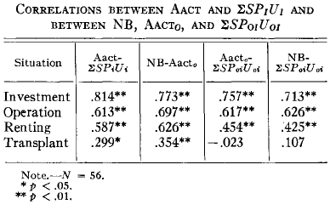
RESULTS
Prediction of Aact
Column 1 of Table 1 presents the correlations between Aact and Subjective Expected Utility for each of the four situations. As expected, all four correlations were significant.
Prediction of NB
Columns 2, 3, and 4 of Table 1 present
intercorrelations of NB, Aact₀, and Subjective Expected Utility .
Consistent with expectations, NB was significantly related to Aact0 in all four situations.
Further, with the exception of Situation 4, the
kidney transplant, Subjective Expected Utility was significantly related to Aact₀ and to NB.

Slide 17
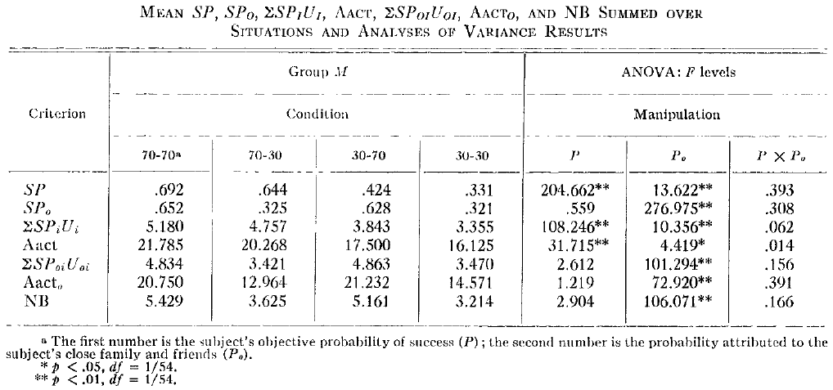
RESULTS
Manipulations of Aact and NB
Table shows the effects produced by variations in the '"objective" probabilities of success (P and P₀) provided in the descriptions of the hypothetical situations.
As predicted, variations in P had significant effects on and on Aact.
Similarly, variations in P₀ had significant effects on , Aact and NB.
Further, just as manipulating P₀ significantly affected SP, the manipulation of
P₀ also had significant effects on and Aact.
In contrast, manipulations of P did not influence SP₀, and they also had no significant
effects on , Aact or NB.
_{n}
∑ SP_{i}U_{i} ^{i=1}
_{n}
∑ SP_{0i}U_{0i}
^{i=1}
_{n}
∑ SP_{i}U_{i} ^{i=1}
_{n}
∑ SP_{0i}U_{0i}
^{i=1}

Slide 18
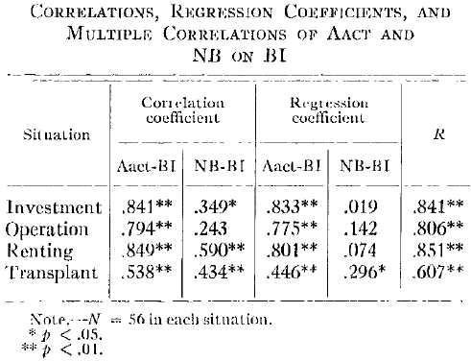
RESULTS
Prediction of BI
Bl should be predictable from Aact and NB.
In all four situations, the subject's intentions were primarily determined by the attitudinal component.
In all four situations, variations in NB should have little or no effect on Bl.

Slide 19
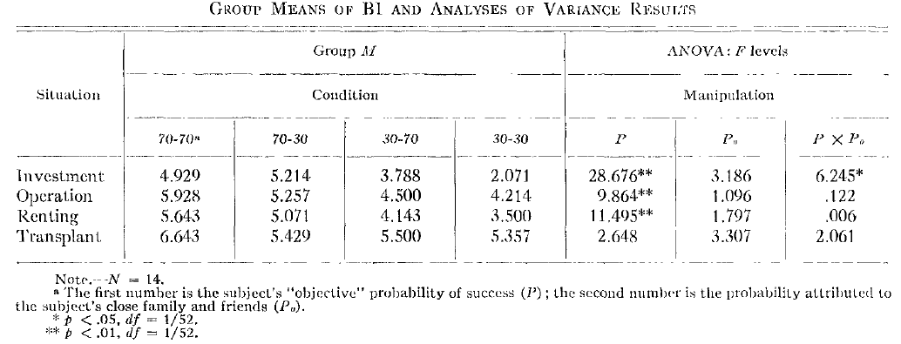
RESULTS
Manipulation of BI
Variations in P were reflected in behavioral intentions in all situations except Situation 4. It will be recalled that the manipulation of P did not produce significant differences in Aact in Situation 4.
Further, variations in P_{o} did not significantly affect intentions.
The demonstration of actual changes in behavioral intentions as a result of changes in the predictor variables (i.e.,Aact and NB) was important.

Slide 20
CHANGE STUDY

Slide 21
METHODOLOGY
A total of 70 subjects participated in the study.
They were given Situation 1 in the 70-70 condition.
After they had read the description of the hypothetical
situation, they completed the questionnaire described
activity for approximately 15 minutes.
Following this interval they were told that they were to
consider Situation 1 again, but that they would be give
some additional information about it.

Slide 22


METHODOLOGY
35 subjects, selected at random, received a "normative" communication,
while the remaining 35 subjects were given an "attitudinal" communication.
At this stage you make a much more extensive investigation of the proposed project, and you come across some information that considerably lowers your estimate of the project's chances to succeed.
You again decide to consult with your family and friends, and you find that they do not share your concern. Indeed, they retain their confidence in the project and still believe it has a 70% chance to succeed.
You, however, now believe that the project's likelihood of success is only 30%.
At this stage, however, some of your friends make a much more extensive investigation of the project and come across some information that considerably lowers their estimates of the project's chances to succeed. They now believe that the project's likelihood of success is only 30%.
You, however, do not share their concern, and you retain your confidence in the project.
That is, you still believe that it has a 70% chance to succeed.

Slide 23
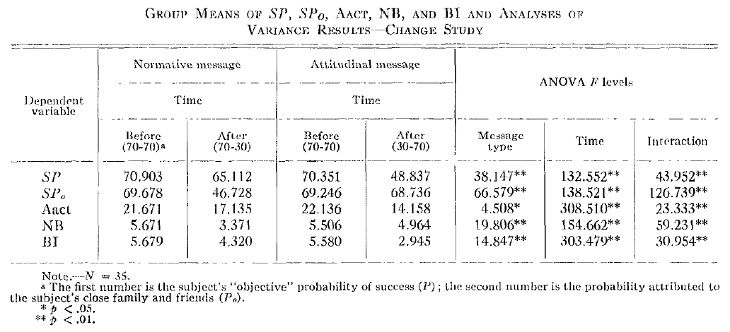
RESULTS
The change study confirmed the results presented earlier.
A change in the subject's probability of success (SP) led to a similar change in Aact,
while the reduction of SP₀ (the subjective probability attributed to relevant others) resulted in a reduction of NB.
Finally, it was shown that the effects of these changes on behavioral
intentions depended on the regression weights of Aact and NB in the prediction of Behavioral Intentions.

Slide 24
CONCLUSIONS
Descriptions of four hypothetical situations involving risk included information
the subject's own estimate of the probability of success (P) was high or low,
the probability of success as estimated by his close family and friends (P0) was
high or low.
The former manipulation was found to influence the subject's attitude toward the risky act (Aact),
while the latter manipulation affected his normative belief (NB), that is, his belief that his close family and friends expected him to perform the risky act.
Consistent with a theoretical model, Aact and NB were found to predict behavioral intentions.
İn all situations, Aact carried more weight than NB in determining intentions, and, consistent with expectations.
A second study demonstrated
A change in P influenced intentions, while a change in P0 did not.

Slide 25
Thank you
☺

